Slide 1
Sideline Coach
Player creator and scoreboard App
Brad Cook

Slide 2

Picture with Caption Layout
NOTE:
To change images on this slide, select a picture and delete it. Then click the Insert Picture icon
in the placeholder to insert your own image.
Caption

Slide 3
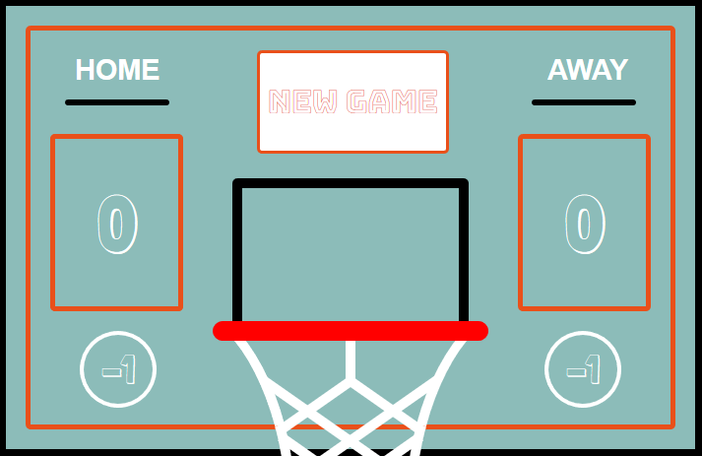
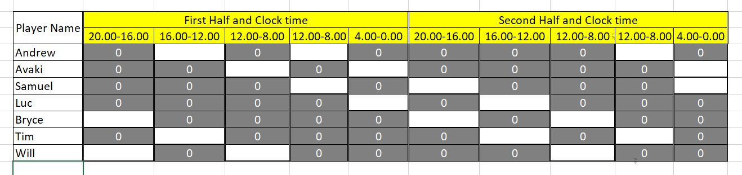
Design Process
It all started with a grand plan!

Slide 4



Notable Technologies Used
ReactJS
Node and WebExpress server
MongoDB

Slide 5
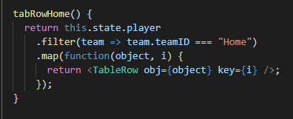
Celebrate your victories!
Array.prototype.filter()
The method creates a new array with all elements that pass the test implemented by the provided function

Slide 6
Add a Slide Title - 1

Slide 7
Add a Slide Title - 2

Slide 8
Add a Slide Title - 3

